Slide 1

WIPRO NGA Program – Embedded Testing
Capstone Project Presentation –17th Feb and 25th Mar 2025
Project Title Here – Zero Bank Capstone Project
Presented by – Akshaya Kumar Dhal
www.rpsconsulting.in

Slide 2

1.Introduction
Zero Bank Capstone Project is a full-scale automation testing initiative designed to validate and enhance the functionality of the Zero Bank application.
This project employs Selenium WebDriver with Java, along with BDD (Cucumber), to automate critical banking workflows such as authentication, fund transfers, and bill payments.
The primary objective is to improve software reliability and ensure a seamless user experience by identifying and finding the potential issues/bugs early.
By integrating Maven for dependency management, Git for version control, and Jenkins for Continuous Deployment, the project establishes a maintainable and scalable test automation framework.
The hybrid framework follows the Page Object Model (POM) pattern, incorporates data-driven testing, and supports multi-browser execution (Chrome, Firefox, IE).
Robust exception handling, logging, and reporting mechanisms (using ExtentReports) ensure clear test analysis. This initiative aims to enhance test coverage, improve execution efficiency, and establish a structured, reusable, and maintainable automation testing suite.
2025 - RPS Consulting all rights reserved

Slide 3
2.Objective
The primary objective is to improve software reliability and ensure a seamless user experience by identifying and finding the potential issues/bugs early.
By integrating Maven for dependency management, Git for version control, and Jenkins for Continuous Deployment execution, the project establishes a maintainable and scalable test automation framework.
The hybrid framework follows the Page Object Model (POM) pattern, incorporates data-driven testing, and supports multi-browser execution (Chrome, Firefox, IE).
Robust exception handling, logging, and reporting mechanisms (using ExtentReports) ensure clear test analysis. This initiative aims to enhance test coverage, improve execution efficiency, and establish a structured, reusable, and maintainable automation testing suite.
2025 - RPS Consulting all rights reserved

Slide 4
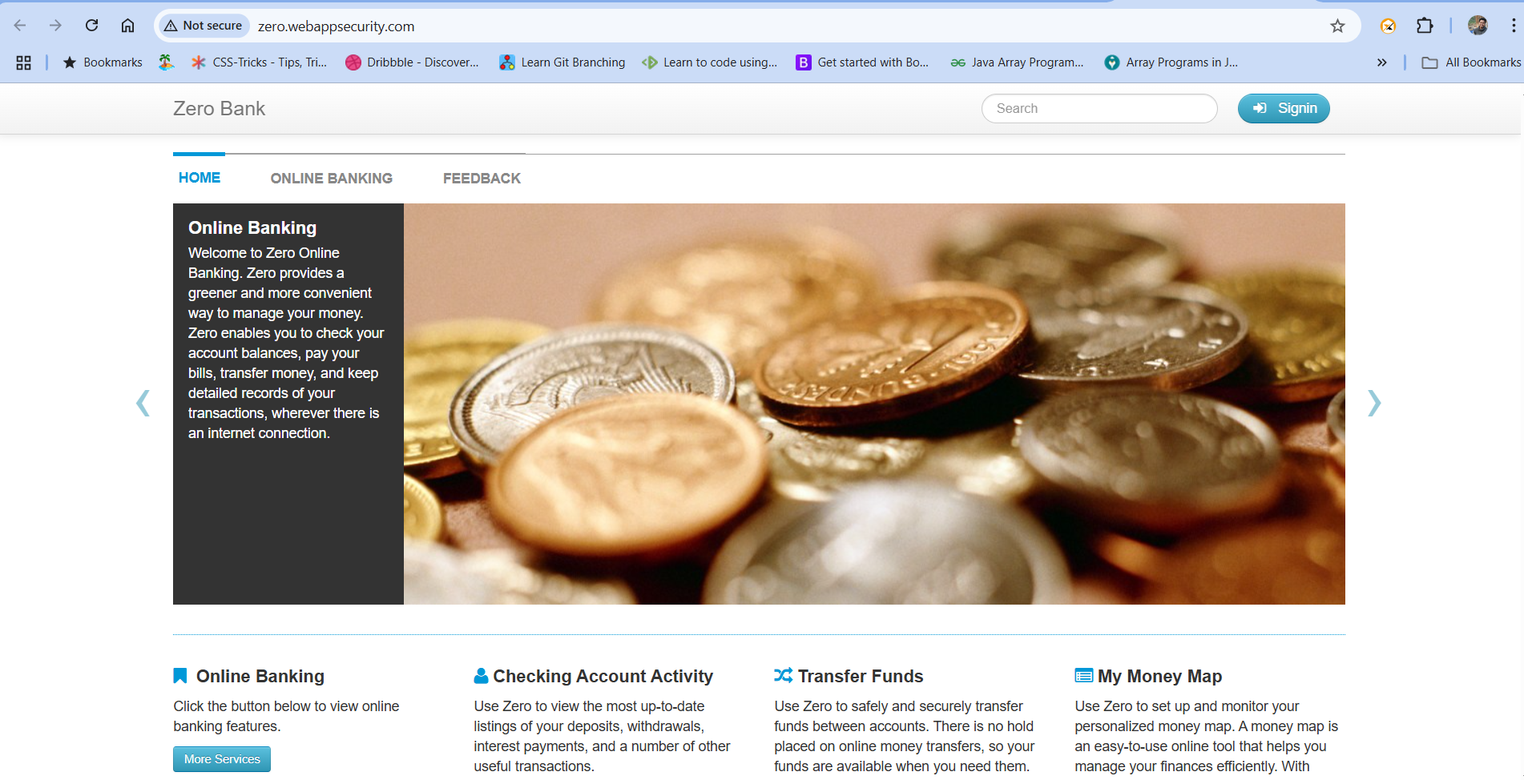
3.About the Application
Application Name: Zero Bank
URL: http://zero.webappsecurity.com/
Browser: Chrome/Firefox/Microsoft Edge
Features: Online banking services including authentication, fund transfers, bill payments, and account management.
2025 - RPS Consulting all rights reserved

Slide 5
4.Testing Process
Tools & Technologies Used
Selenium WebDriver – Browser automation Java – Test script development Maven – Dependency & build management Git – Version control system Jenkins – CI/CD pipeline execution BDD (Cucumber) – Writing feature files for test scenarios TestNG – Test execution and reporting
Automation Framework Design Considerations
Hybrid Framework with POM (Page Object Model) Design.
Multi-browser execution (Chrome, Firefox, IE).
Data-driven testing using Apache POI.
Exception handling & logging.
Reports generation using Extent/Allure Reports.
2025 - RPS Consulting all rights reserved

Slide 6
5.Functionalities
Authentication: Login and logout functionality with validations for incorrect credentials and empty fields.
Account Summary: Verification of account details, balances, and different account types (Checking, Savings, Credit Card, Loan).
Fund Transfer: Money transfers between accounts, validating successful transfers, insufficient funds, and negative values.
Bill Payments: Automated bill payments with validation for missing amounts and scheduling future payments.
New Payee Addition: Ensuring payees can be added successfully with validation for missing details.
Statements & Documents: Verification of account statement downloads in PDF format.
Logout Functionality: Ensuring secure logout and preventing access to previous pages after logging out.
2025 - RPS Consulting all rights reserved

Slide 7
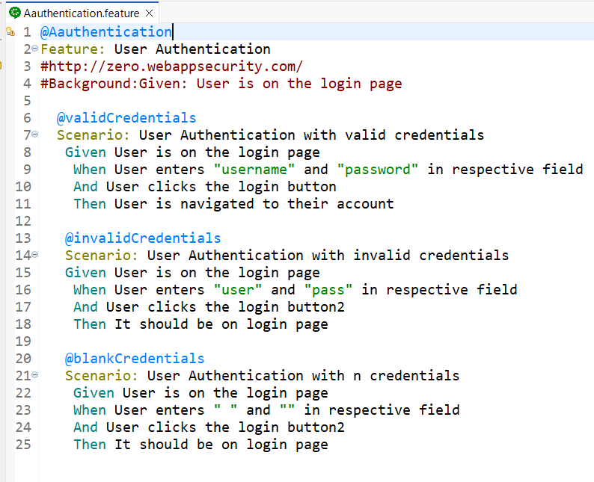
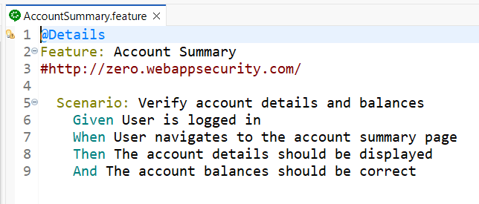
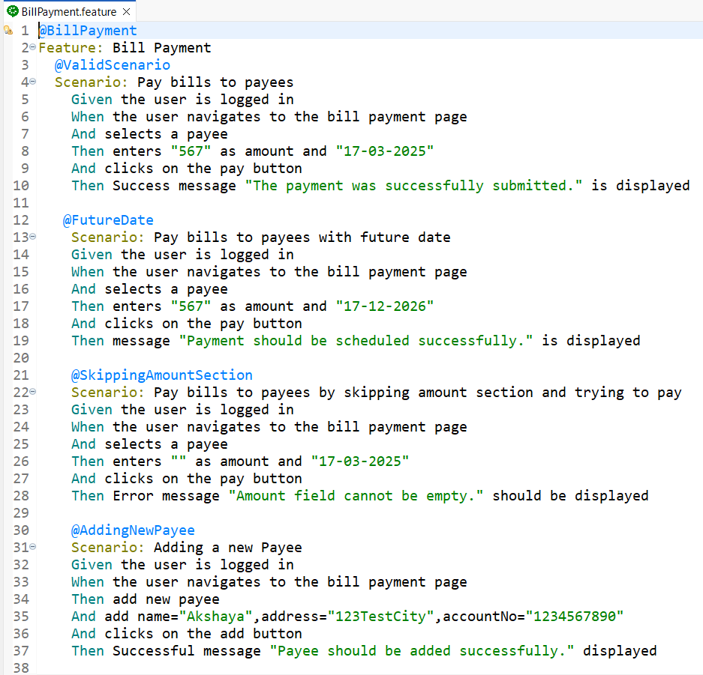
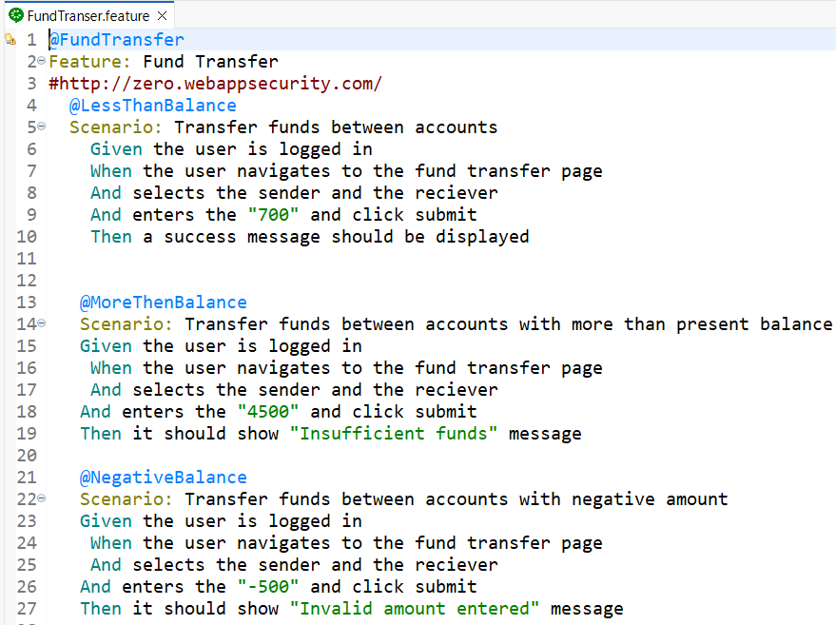
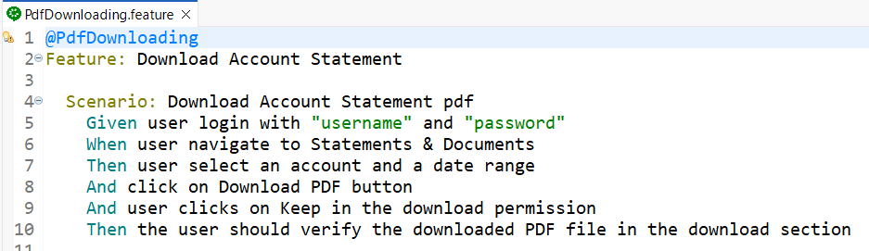
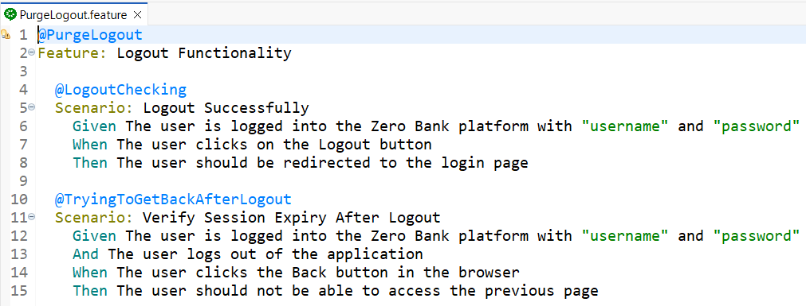
6.Feature Files
2025 - RPS Consulting all rights reserved

Slide 8
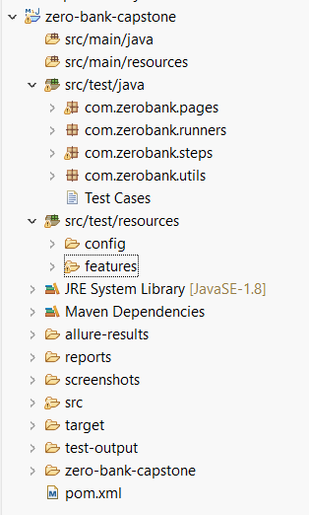
7.Project Structure
Src/test/java
/pages-all the locators and methods are present here
/runner- a class extended to “AbstractTestNGCucumberTests” is a class provided by the Cucumber TestNG integration. It allows you to execute Cucumber feature files using TestNG as the test runner.
/step Definitions- is the technical side of feature file and it connect all feature files to the actual automation code
/utility- contains re-use common functionalities like browser setup, reading data from Excel, taking screenshots, handling waits, etc
Src/test/resources
/Features- It contains test scenarios written in Gherkin syntax, which is easy to read and understand.
/config-It helps in managing environment settings such as browser details, URLs, timeouts, database configurations, and test data paths .
2025 - RPS Consulting all rights reserved

Slide 9
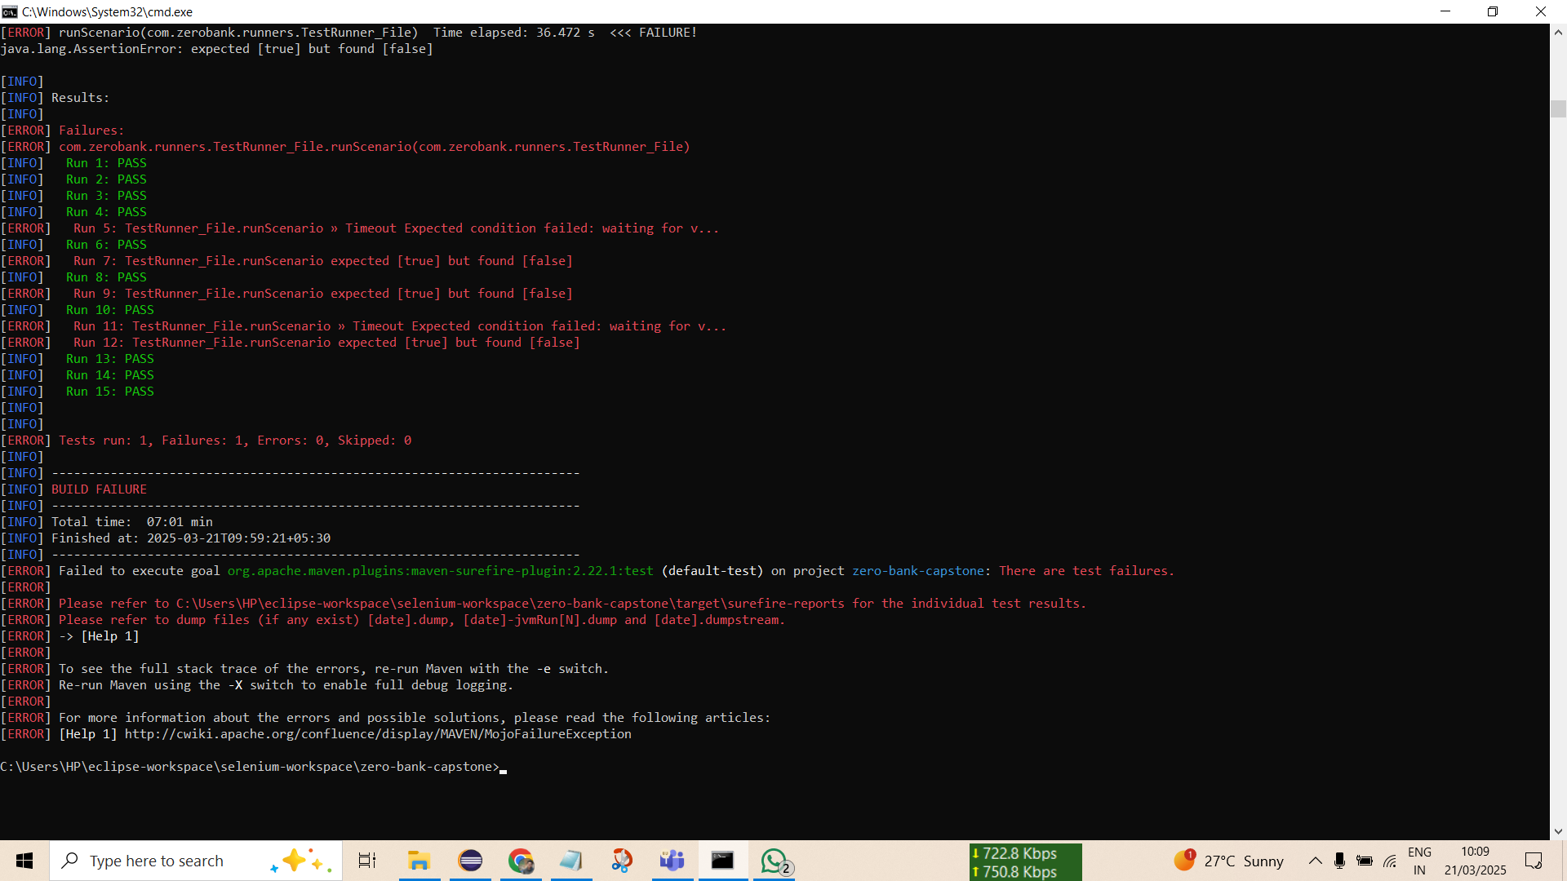
7. Screenshots of test cases, reports, screenshots and log
Test Cases:
2025 - RPS Consulting all rights reserved

Slide 10
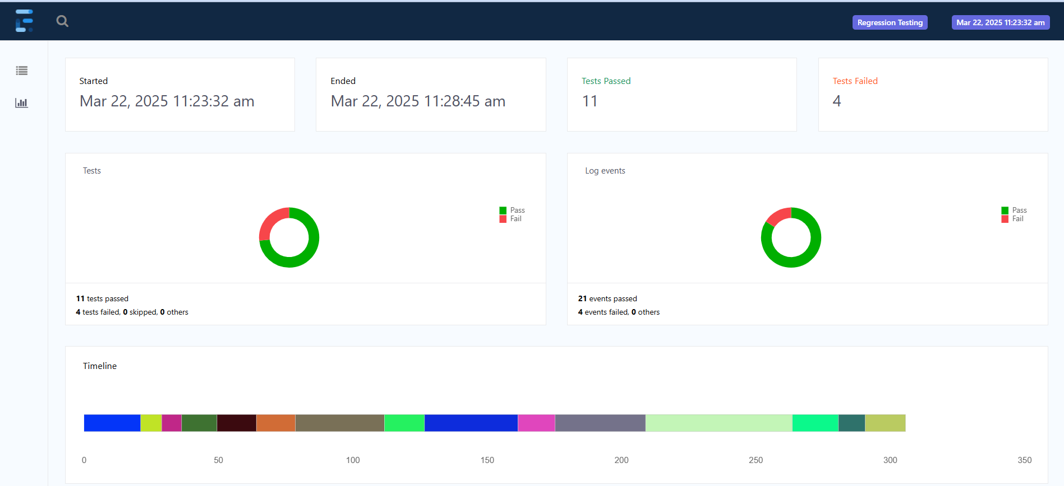
Extend Report:
2025 - RPS Consulting all rights reserved

Slide 11
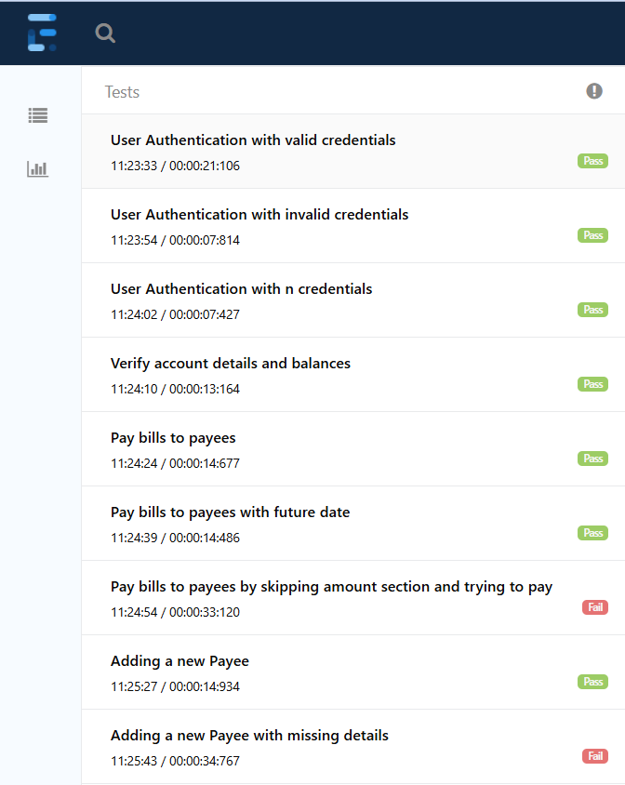
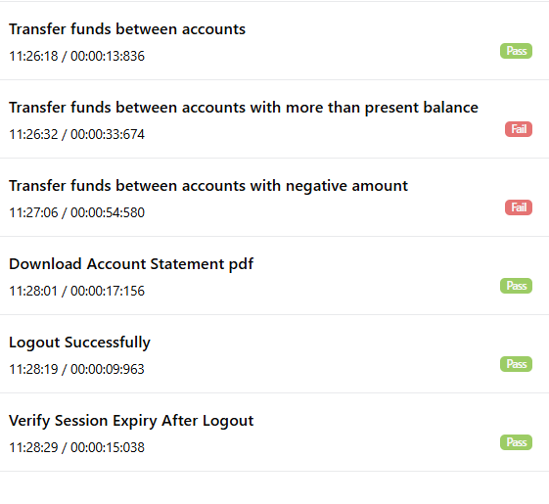
Extend Report:
2025 - RPS Consulting all rights reserved

Slide 12
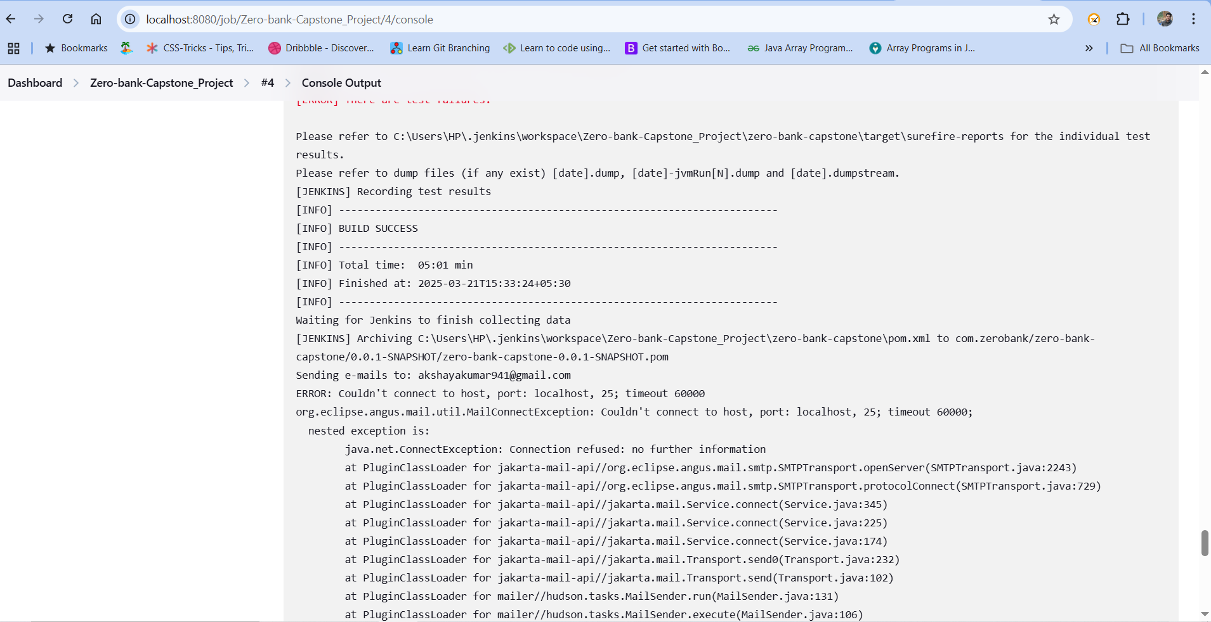
Jenkins Execution:
2025 - RPS Consulting all rights reserved

Slide 13
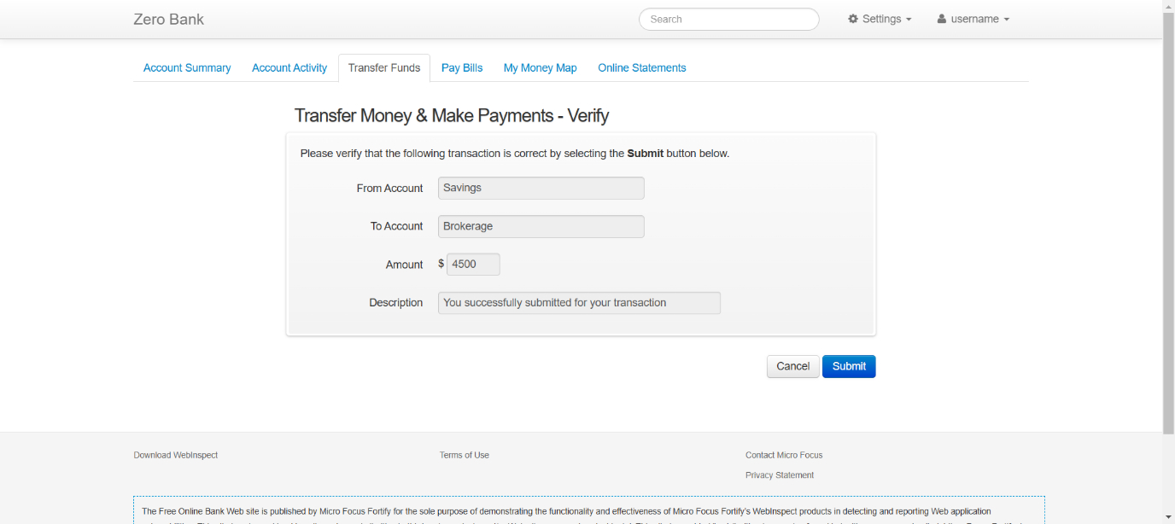

8.Bug Identified
TC-7-->Failed(Getting successfully transferred but it should show "insufficient balance")
TC-8-->Failed(Getting successfully transferred but it should show "invalid amount entered")
2025 - RPS Consulting all rights reserved

Slide 14
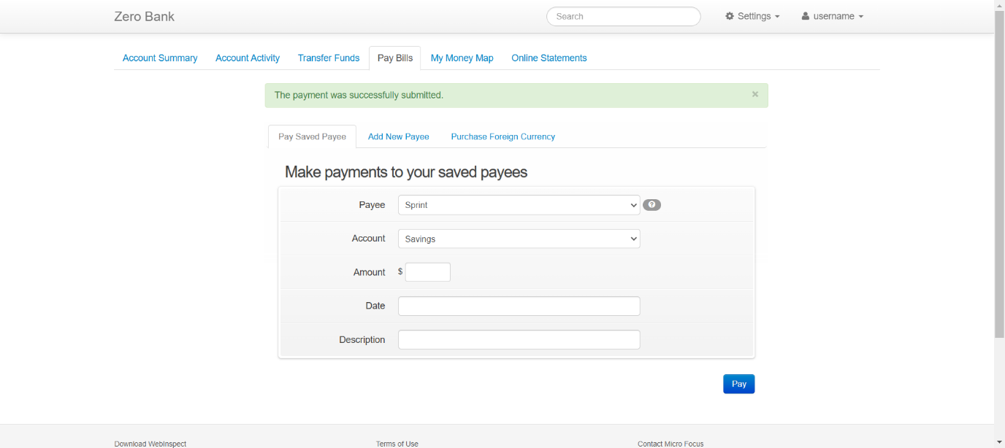
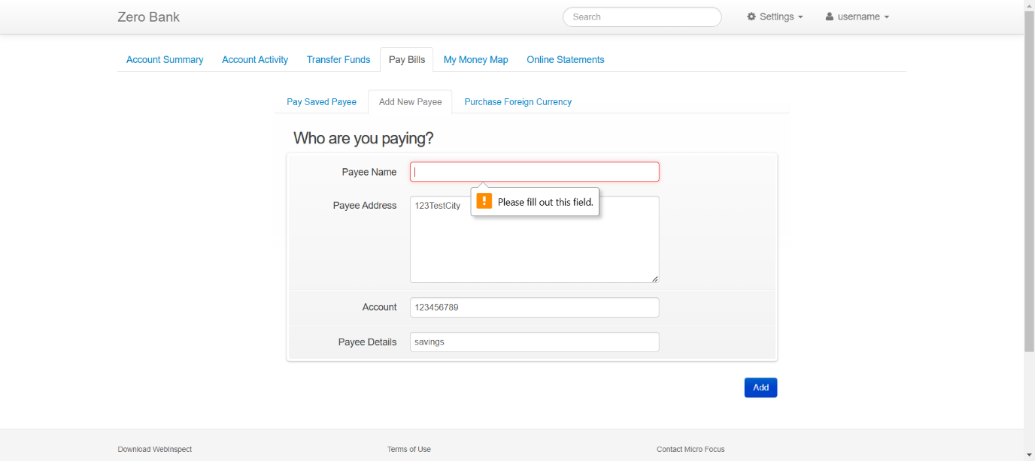
TC-10-->Failed(Getting message "The payment was successfully submitted" but should get "Payment should be scheduled successfully")
TC-13-->Failed(Getting message "Payee added successfully" but should get message "All fields are mandatory")
2025 - RPS Consulting all rights reserved

Slide 15
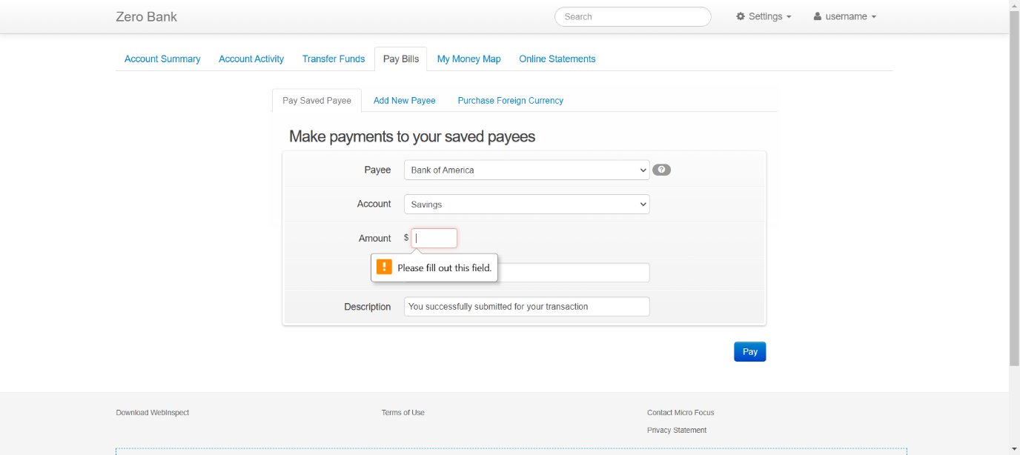
TC-13-->Failed(Getting message "Payee added successfully" but should get message "All fields are mandatory")
2025 - RPS Consulting all rights reserved

Slide 16
9.Conclusion
Successfully automated the key functionalities of the Zero Bank application.
Implemented a robust hybrid automation framework with POM, data-driven testing, and BDD.
Ensured test reusability, maintainability, and readability.
Integrated Jenkins for CI/CD and Git for version control.
Generated detailed reports for better analysis and debugging.
2025 - RPS Consulting all rights reserved

